Slide 1
Governance and buying: policy, risk register and vendors
What rules, risk register and vendor checks does my organisation need for AI?
Leading with AI | Session 13 of the 15 (Sessions 0 to 14)
KLAi Professional Learning | Jotham Martin Wambi
Notes:
Welcome back. In Session 12 you planned for your people: the role task by task, skills, the three fears and an employee briefing that says what is approved and what is not. Today we write the rules that keep those promises: an acceptable use policy, a risk register, data rules, the law, and how to question what a vendor sells you.
I am not a lawyer, so every legal point is my understanding, for you to confirm with yours. Then you spend an hour on your own drafts.

Slide 2



What you will leave with today
By the end of today you will have
A first draft of your acceptable use policy and a risk register for your own AI uses, each risk owned and controlled
A plain view of the law in Uganda and beyond, and a page of questions for your lawyer
Vendor questions with the answers that would worry you, the full first-year cost in shillings, and a one-page board briefing
Notes:
That question gives you three things to hold by the end. A first draft of your acceptable use policy and a risk register for your own AI uses, each risk with an owner and a control. A plain view of the law in Uganda and beyond, with a page of questions for your lawyer.
And vendor questions with the answers that would worry you, the full first-year cost in shillings, and a one-page board briefing.

Slide 3
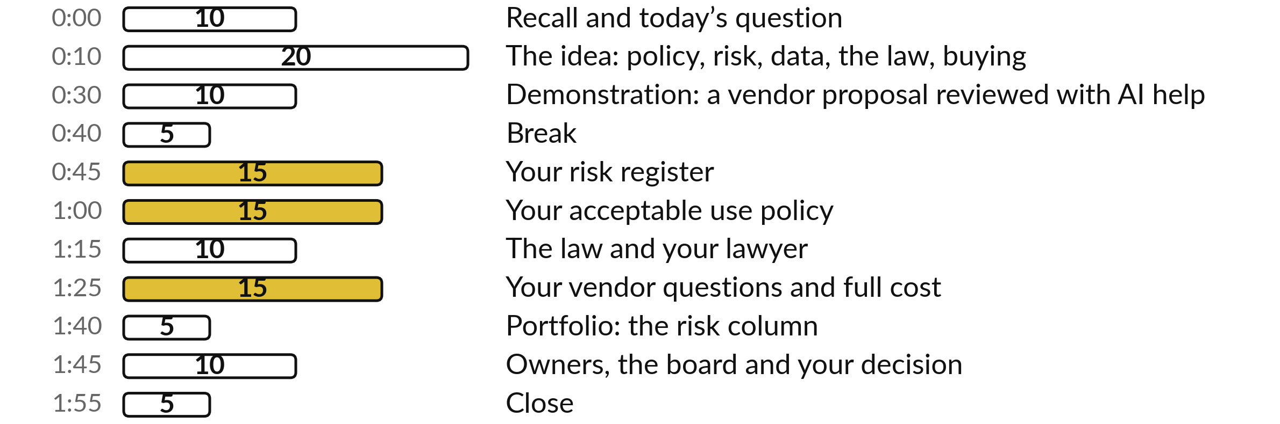
Your two hours: an hour of it is your own rules
I show a recorded vendor review. You draft your register, policy, lawyer page and vendor questions.
Notes:
Here is how the two hours run. Ten minutes to recall Session 12 and meet today’s question. Twenty minutes on the ideas: the policy, the risk register, data classification, the law and buying. Ten minutes on a recorded demonstration: a vendor proposal reviewed with AI help. A five-minute break, then a full hour of your own work in five blocks.
Ten minutes on who owns it, the board briefing and your decision, and five to close. First, three questions on last session.

Slide 4
Three questions from last time
1. In Session 12, what three things can happen to a task when AI arrives?
2. Which three fears did you answer, and how?
3. What did your employee briefing say about approved tools?
Answer aloud first. Then we check together.
Notes:
Three quick questions from Session 12. Answer aloud first, and then we check together.
Question one. In Session 12, what three things can happen to a task when AI arrives? Take a moment.
A good answer is this. AI augments it (helps, a person decides), automates it (does it, a person checks), or new tasks are created, such as checking AI output.
Question two. Which three fears did you answer, and how? Say it to yourself first.
A good answer is this. Losing my job, being watched, being blamed. For each, what we say and what we do, and only promises we can keep.
Question three. What did your employee briefing say about approved tools? Think about your own work as you answer.
A good answer is this. What is approved, such as the company assistant, and what is not, such as pasting customer data into personal AI tools. Today that line becomes a policy.
If an answer was missing, last session’s take-away sheet has it.

Slide 5
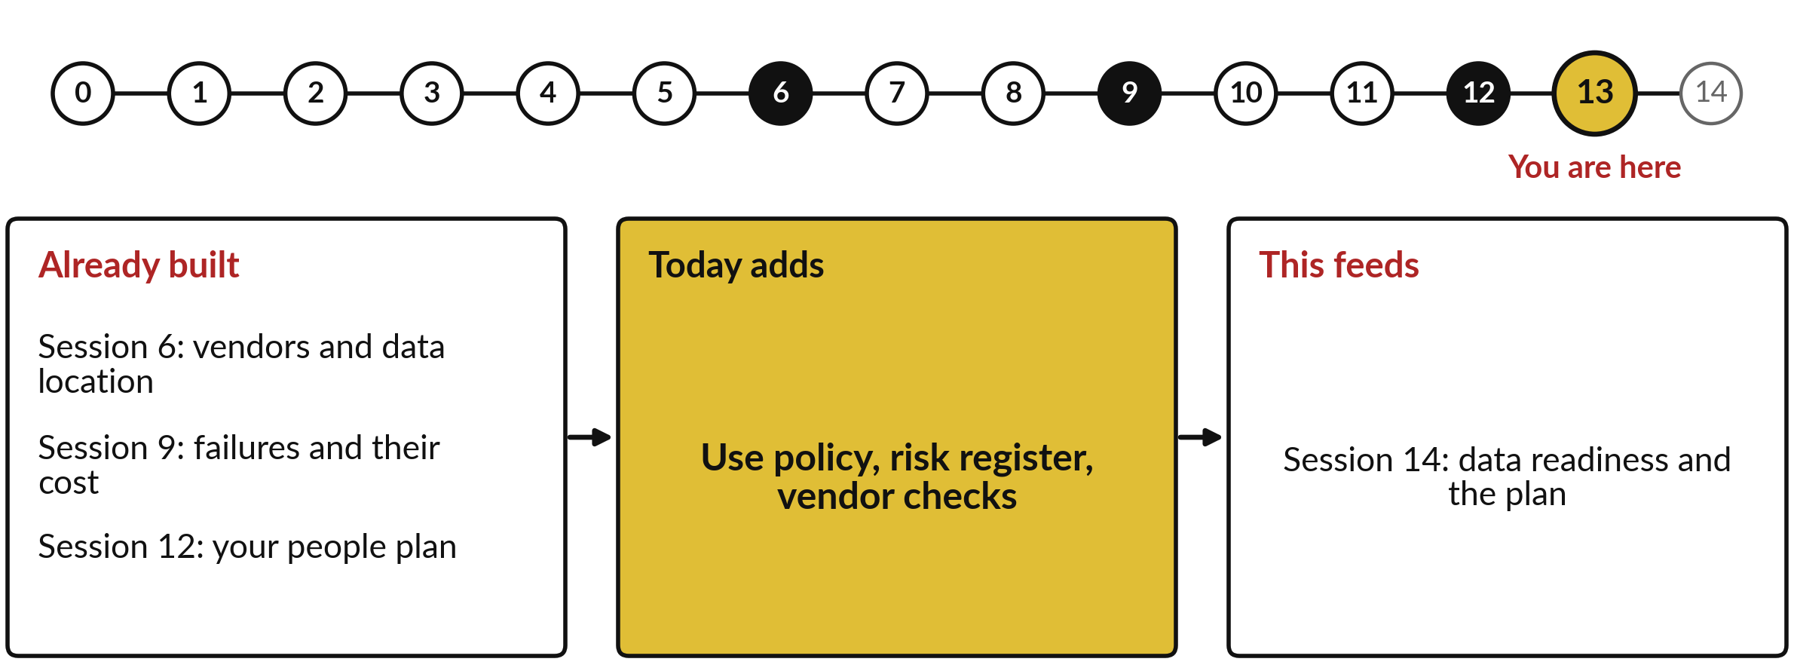
What today builds on, and where it leads
Each session is built on the ones before it.
Notes:
The dots along the top are the fifteen sessions, from the map at Session 0 to your plan at Session 14; the gold one is today.
Today uses vendors and data location from Session 6, failures and their cost from Session 9 and your people plan from Session 12.
It adds use policy, risk register, vendor checks.
Session 14: data readiness and the plan.

Slide 6
Words we use today
Word | What it means
AI governance | The policies, roles and checks by which an organisation directs and controls its use of AI.
Acceptable use policy | A written rule on who may use which AI tools, for what, and with what data.
Risk register | A table of what could go wrong, each risk scored for likelihood and impact, with an owner and a control.
Data classification | Sorting information into levels, such as public or confidential, each with its own handling rule.
Vendor due diligence | Checking a supplier’s claims, security and contract terms before you commit.
Total cost of ownership | Everything you will pay over the life of a tool: set-up, fees, people’s time and leaving.
Notes:
6 words for today. We use every one of them before the end of the session.
AI governance. The policies, roles and checks by which an organisation directs and controls its use of AI.
Acceptable use policy. A written rule on who may use which AI tools, for what, and with what data.
Risk register. A table of what could go wrong, each risk scored for likelihood and impact, with an owner and a control.
Data classification. Sorting information into levels, such as public or confidential, each with its own handling rule.
Vendor due diligence. Checking a supplier’s claims, security and contract terms before you commit.
Total cost of ownership. Everything you will pay over the life of a tool: set-up, fees, people’s time and leaving.

Slide 7
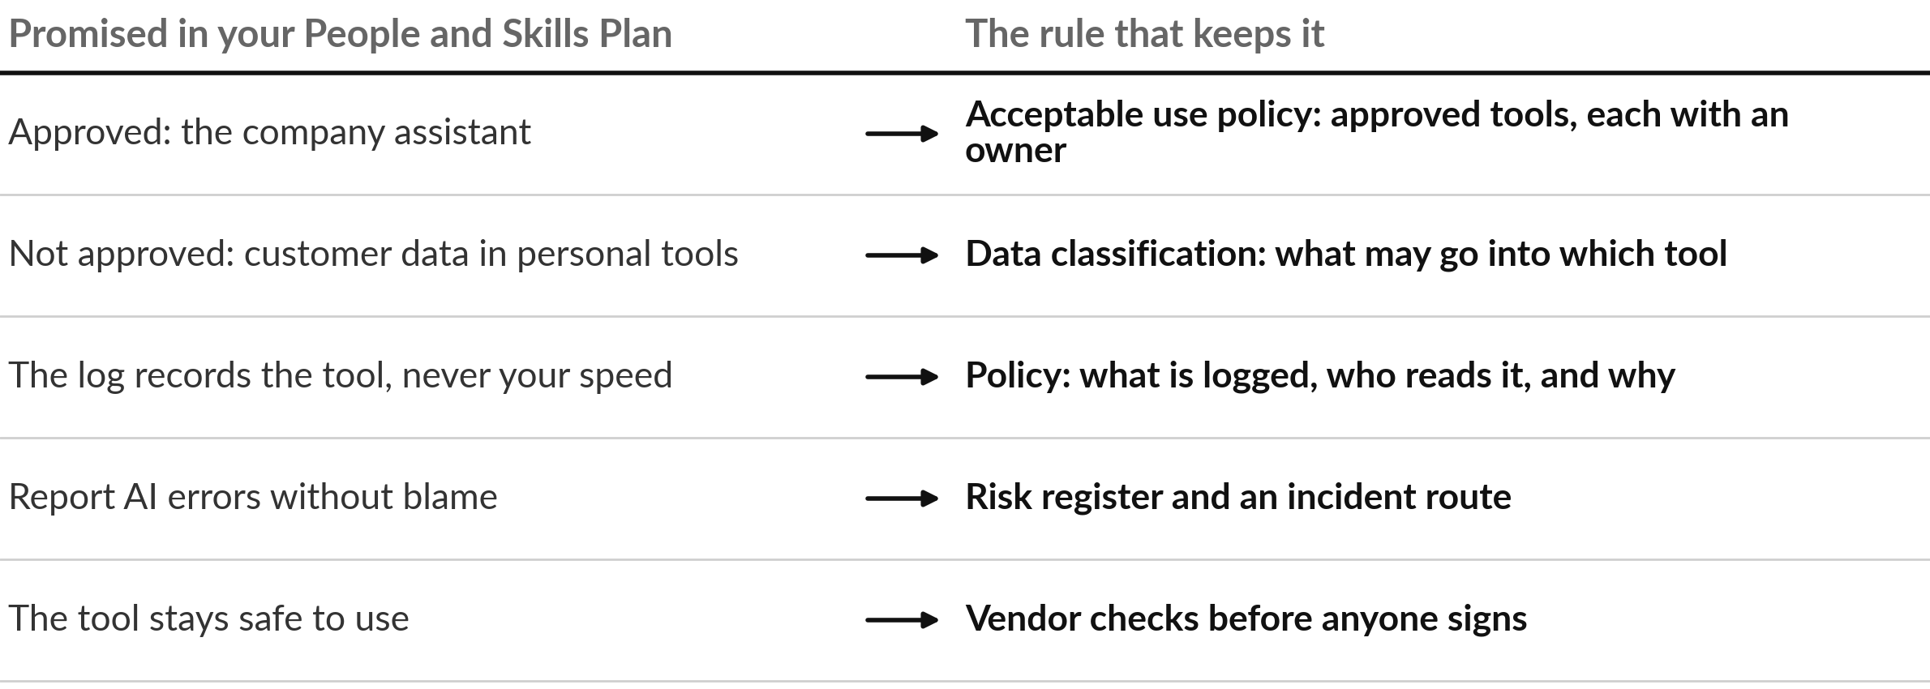
Each promise in your people
plan needs a rule behind it
Today you write the right-hand column for your own organisation.
Notes:
Those six words serve one purpose, keeping promises. Last session your briefing told staff what is approved and what is not, that the log records the tool and never their speed, and that reporting an AI error is praised. Each promise needs a rule behind it, or it is only words.
Approved tools become an acceptable use policy. The line on customer data becomes data classification. The promise about the log becomes a policy line on what is logged and who reads it. Reporting errors becomes a risk register and an incident route. And a safe tool starts with vendor checks before anyone signs. An East African airline already works this way.

Slide 8
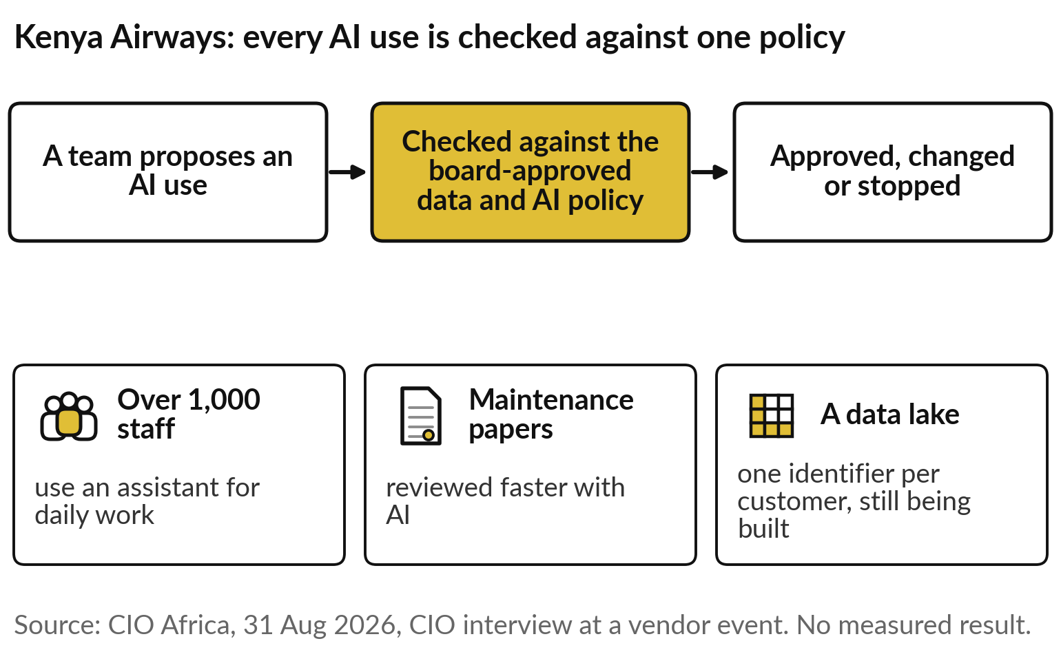
Kenya Airways’ board approved a data and AI
policy, and every new use is checked against it
One policy, from the top, and the same check for every use.
More than 1,000 staff use an assistant daily.
No measured result yet; it was said at a vendor event.
Notes:
Kenya Airways is one answer. Its chief information officer told CIO Africa in August 2026 that the airline has a dedicated data and AI policy approved by the board, and that each new AI use is checked against it. More than 1,000 staff use an assistant for daily work, AI speeds the review of maintenance documents, and a data lake that gives each customer one identifier is still being built.
Two cautions: it was said at a vendor’s event, and no measured result was given. What we can borrow is the shape: one policy, from the top, and the same check for every use. Today’s question follows: what rules, register and vendor checks does your organisation need?

Slide 9
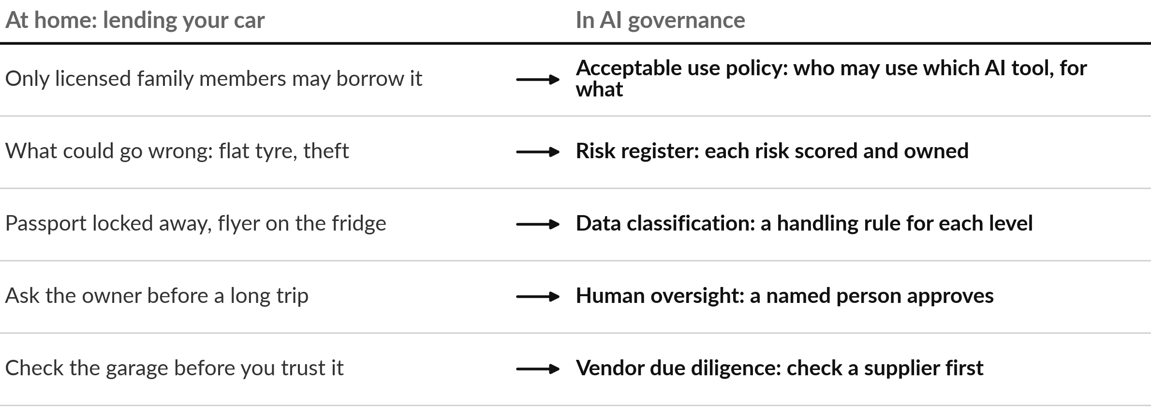
AI governance is the set of house rules
you already use when you lend your car
AI governance: the policies, roles and checks by which an organisation directs and controls its AI use.
Notes:
Governance can sound like paperwork, so start with something you already do. When you lend your car you decide who may borrow it, you know what could go wrong, you keep the passport locked away, you ask to be told before a long trip, and you check a garage before trusting it with the car.
Each habit has a name in AI governance, which is the policies, roles and checks by which an organisation directs and controls its use of AI. The analogy breaks in one place: a car has one obvious owner, while in a company you must name who answers. Some leaders skip all of this and ban AI outright, which brings its own trouble.

Slide 10
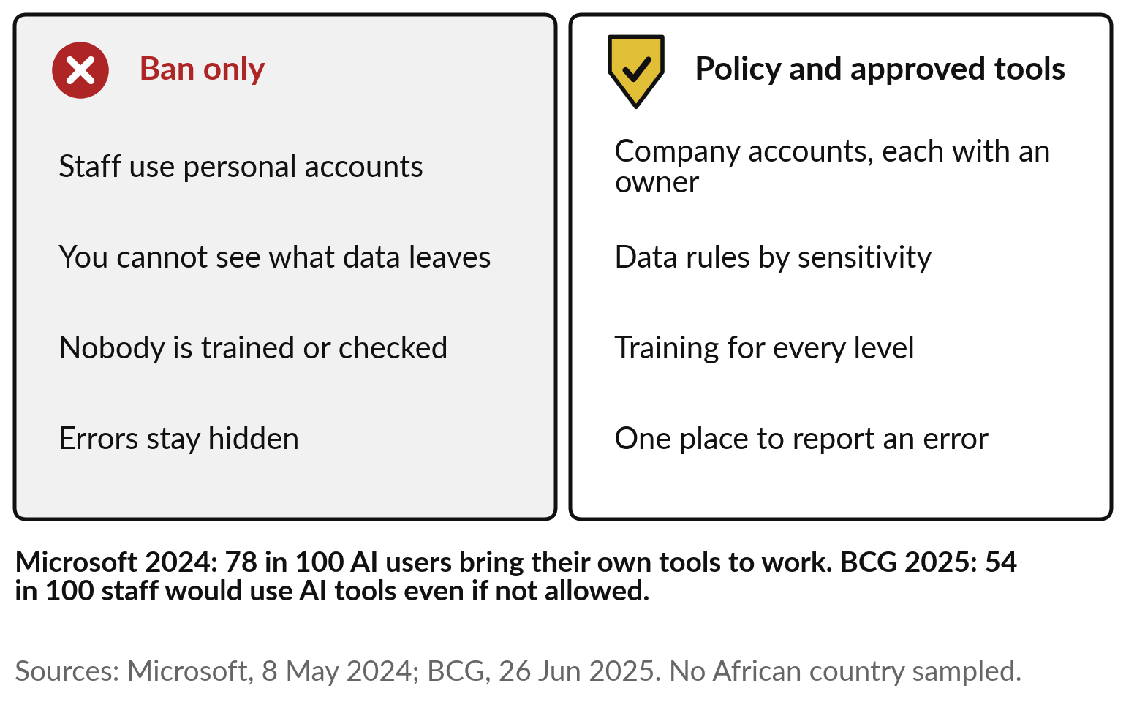
A ban pushes AI use out of sight; an
acceptable use policy gives staff a safe route
Staff already use AI. The question is whether you can see it.
Shadow AI, from Session 0, is use without approval.
Ask your own staff; neither survey sampled Africa.
Notes:
In my experience, a ban pushes the use out of sight. Think of a school that bans phones: they end up in bags and under desks. Staff keep using personal accounts, you cannot see what data leaves, nobody is trained and errors stay hidden. That is the shadow AI of Session 0.
Microsoft’s 2024 survey found 78 in 100 AI users bring their own tools to work, and in BCG’s 2025 survey 54 in 100 staff would use AI tools even if not allowed. Neither sampled an African country, so ask your own people. An acceptable use policy with approved tools gives people a safe route and lets you see the use, and it is shorter than most people expect.

Slide 11
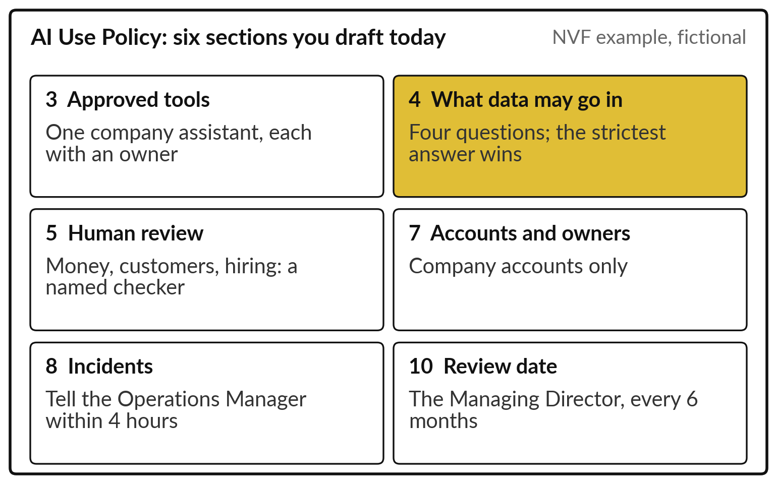
An acceptable use policy fits on a page: tools,
data, review, owners, incidents, a review date
Six of the eleven sections of the AI Use Policy Template, drafted today.
Plain enough for a new clerk.
Names people, with dates.
Notes:
A policy that people follow fits on a page. The AI Use Policy Template has eleven sections, and you draft six today. Section three, approved tools, each with an owner. Section four, what data may go in, which we build in a moment. Section five, human review: what always needs a named checker, such as money, customers and hiring.
Section seven, accounts and owners: company accounts only. Section eight, incidents: who hears about a problem, and how fast; here, the Operations Manager within four hours. And section ten, the review date. The Nile Valley Foods example is fictional. A sector can write such rules too, as Kenya’s courts are doing.

Slide 12
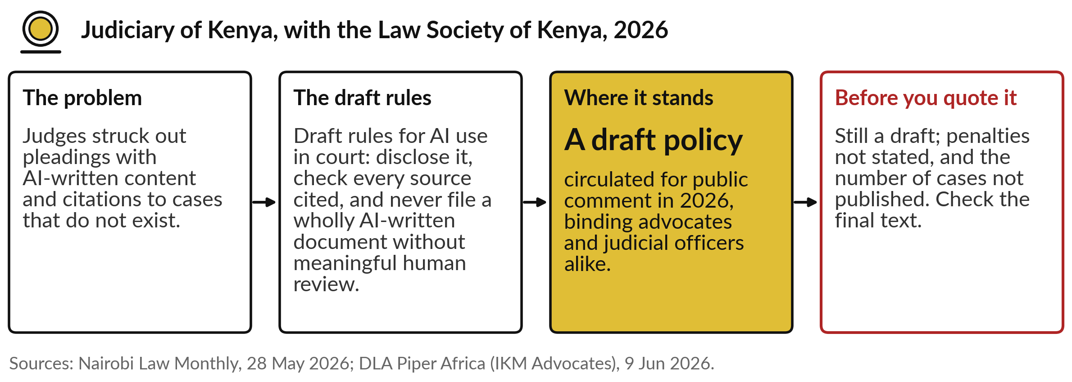
After fake citations reached Kenya’s
courts, the Judiciary drafted rules on AI use
The invented sources of Session 9 turned into rules: disclose, verify, a person reviews.
Notes:
A whole sector can write its policy after a failure. In Kenya, several judges struck out pleadings that contained AI-written content and citations to cases that do not exist, the invented sources we met in Session 9. In 2026 the Judiciary, with the Law Society, circulated draft rules: advocates must disclose AI use when filing, must check every authority they cite, and may not file a wholly AI-written document without meaningful human review.
Judicial officers must check AI output too. It is still a draft, penalties are not stated, and the number of incidents was not published, so check the final text before you quote it. Rules like these reach into what goes into a tool, which brings us to data.

Slide 13
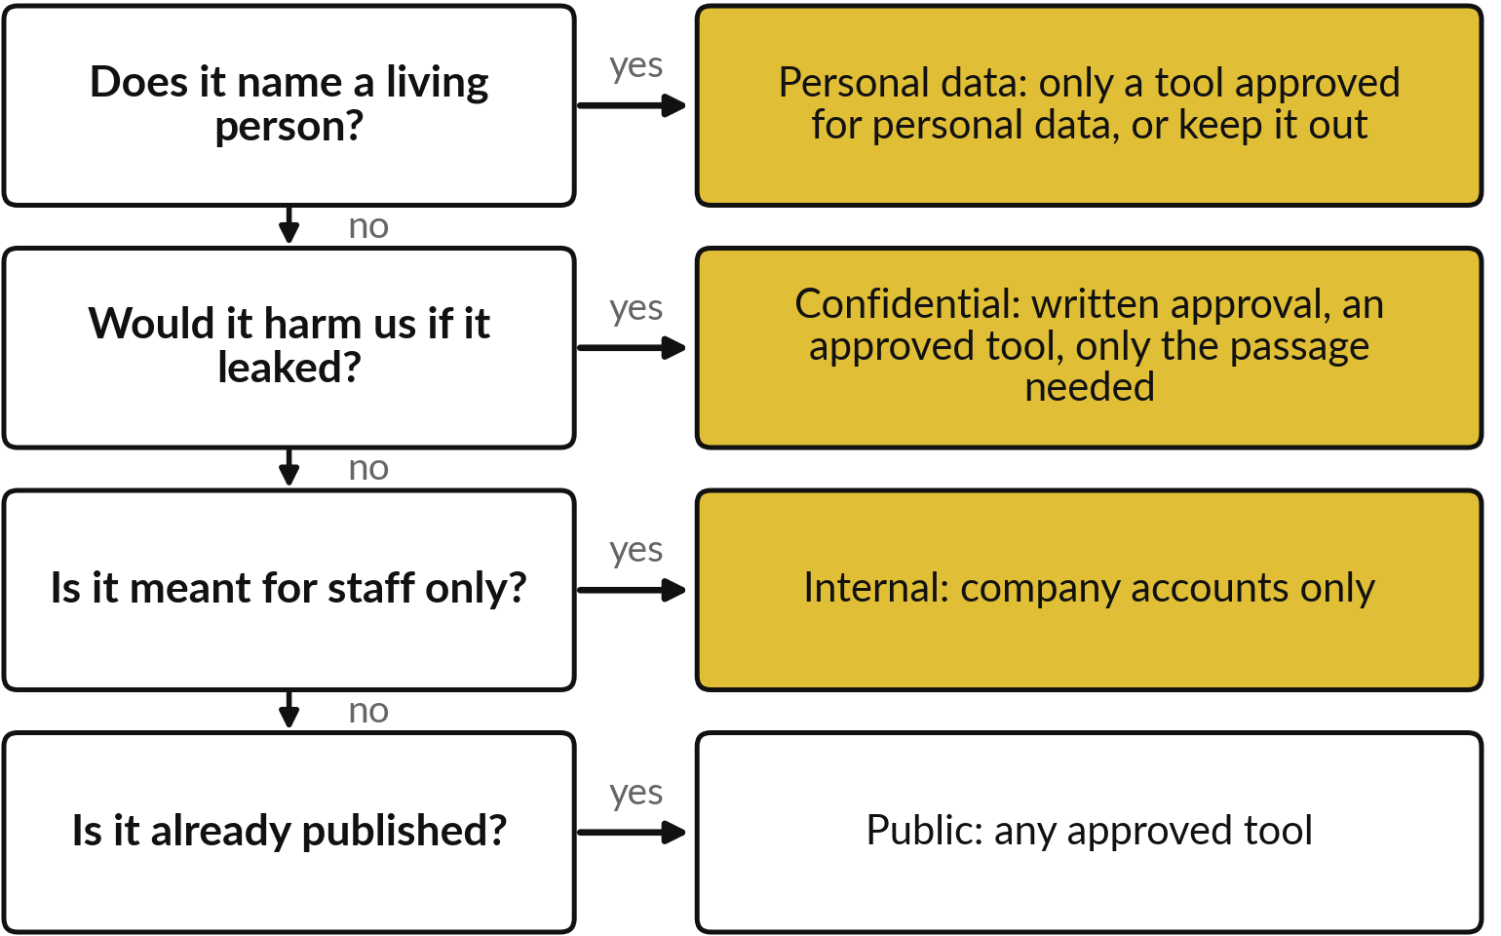
Four questions tell staff what
data may go into an AI tool
Like papers at home: the passport locked away, the flyer on the fridge.
The strictest answer wins.
When unsure, treat it as one level more sensitive.
Notes:
Data classification is the rule that guards your customers’ information. At home a passport is locked away and a flyer sits on the fridge. Classification sorts information by the harm a leak would cause and gives each level a handling rule. Staff ask four questions in order. Does it name a living person?
Then it is personal data, which Uganda’s Data Protection and Privacy Act of 2019 protects. Would it harm us if it leaked?
Confidential. Is it for staff only?
Internal. Is it already published?
Public. The strictest answer wins, so payroll is personal and confidential. That is section four. With the rules written, list what could still go wrong.

Slide 14
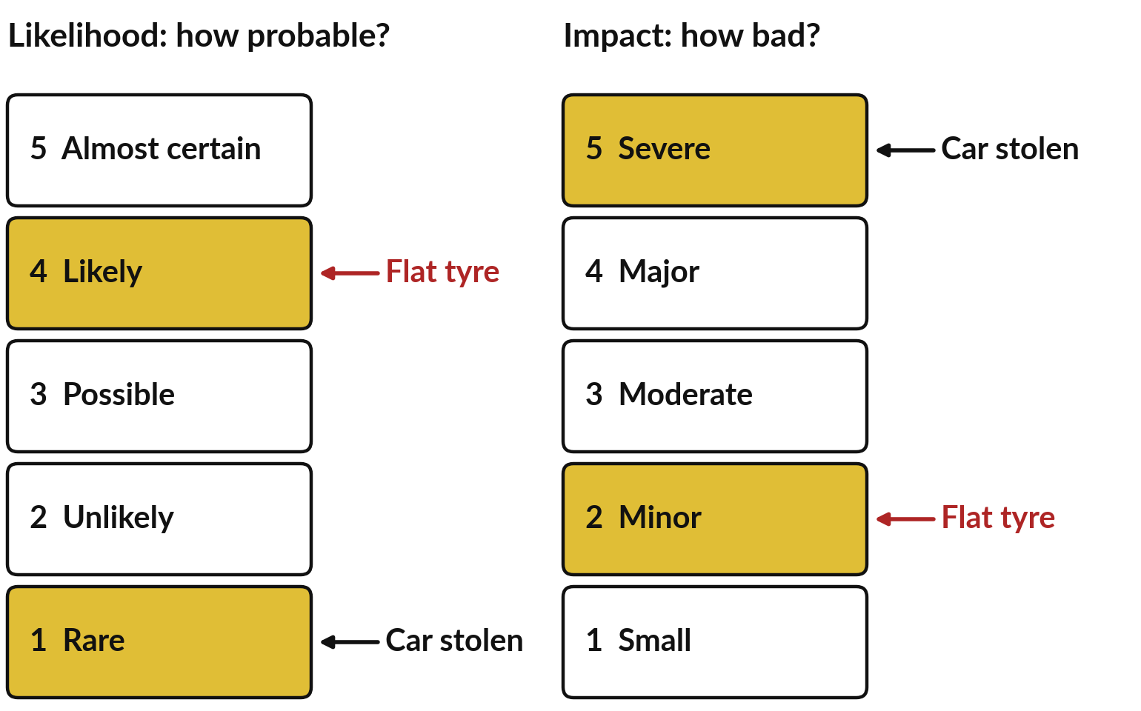
A risk register scores each risk twice,
from 1 to 5: how likely, and how bad
As in Sessions 9 and 10: how likely, and how costly.
Likelihood is judged over the next 12 months.
Words on each step, so two people score alike.
Notes:
In Session 9 we weighed an error by how likely it is and how costly it would be, and in Session 10 we saw agents with too much freedom. Exact chances and shilling costs are rare, so the Risk Register template scores each from one to five, with words so that two people score alike.
Likelihood runs from rare to almost certain, over the next twelve months. Impact runs from small, a few minutes of rework, to severe, serious harm or legal action. Back to the car. A flat tyre is likely, four, and minor, two. A stolen car is rare, one, and severe, five.
The two scores have to be combined before you can say which worries you more.

Slide 15
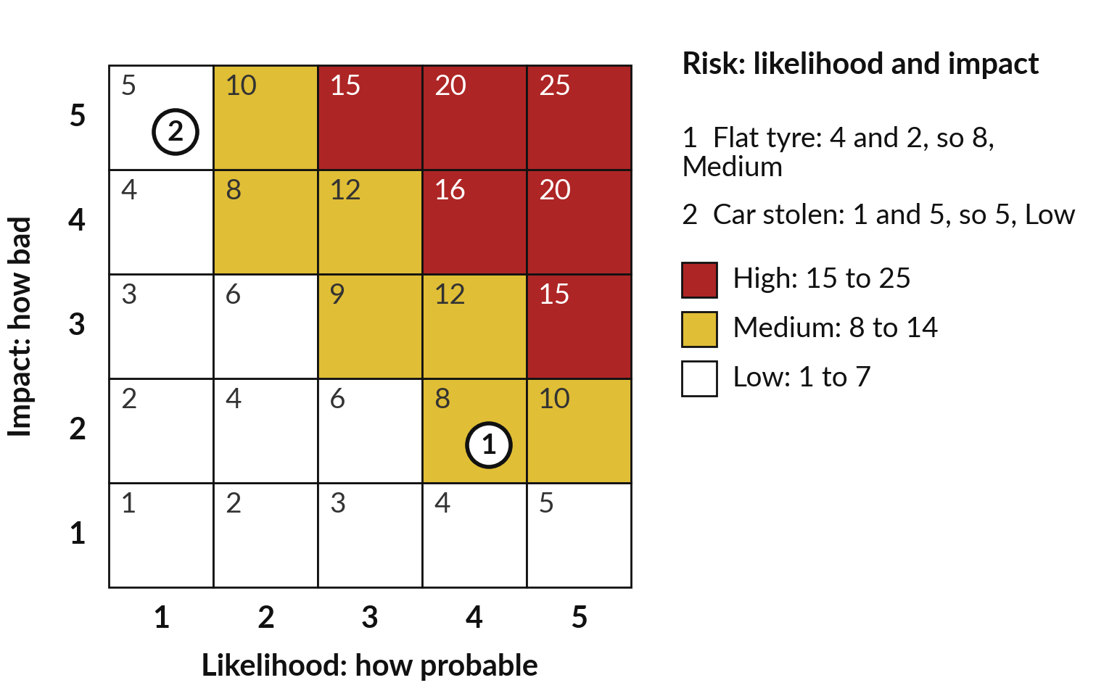
Multiplying the two scores ranks the risks,
so a likely but minor flat tyre is Medium
A one on either side keeps a risk small.
High needs a control and a report to the top.
Medium needs a control.
Low you accept and watch.
Notes:
To rank them, multiply the two scores, and the grid does it for you: each square shows its result. The flat tyre is four and two, so eight. The stolen car is one and five, so five. A risk matters when it is both fairly likely and fairly bad, so a one on either side keeps it small.
The smallest square is one, the largest twenty-five. The template turns the score into a level: High from fifteen, red, needs a control and a report to the Managing Director. Medium, eight to fourteen, gold, needs a control. Low, below eight, you accept and watch. So the tyre is Medium, and needs a control, such as a spare in the boot.

Slide 16
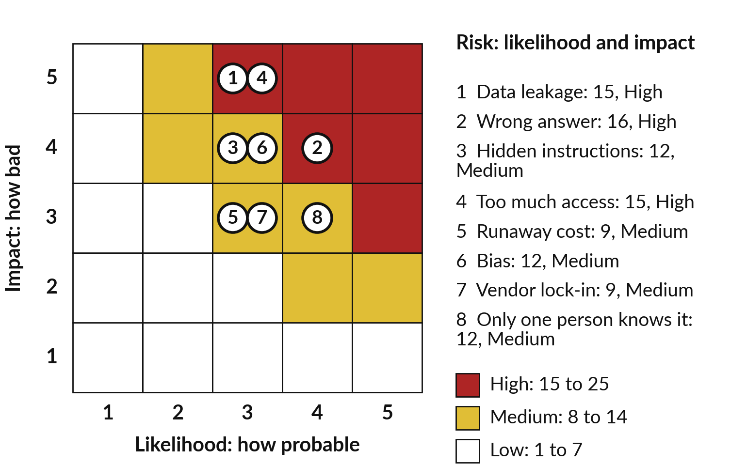
Three of the template’s eight
typical AI risks score High
Most are failures you met in Sessions 9 and 10.
These are the template’s example scores; yours may differ.
Every High and Medium needs a control.
Notes:
The Risk Register template has eight grey rows, scored the same way, and most are failures you met. A wrong answer, the invented facts of Session 9, is likely and major: sixteen, High. Data leakage and too much access, an assistant given a whole mailbox as in Session 10, are fifteen each, High.
Hidden instructions and bias are twelve, Medium. A runaway cost, a loop that keeps calling a paid service, is nine, and so is vendor lock-in, data you cannot move to another supplier. When only one person knows how it works, twelve. These are example scores; you score your own after the break, and some will sit higher in your organisation.

Slide 17
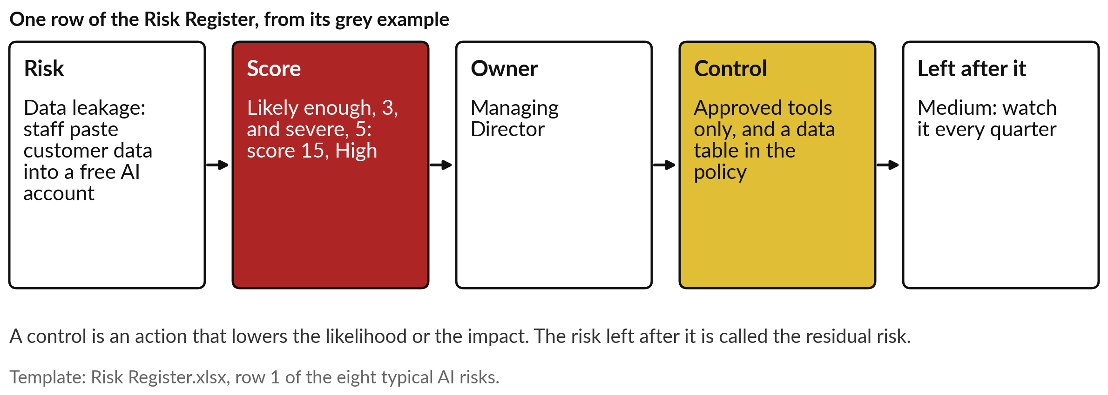
Each row of the register names an owner,
a control, and the risk left after the control
An owner is one named person. A shared risk has no owner.
Notes:
The score tells you where to look; the rest of the row says who acts. Take data leakage, the first row of the template: staff paste customer data into a free AI account. Likely enough, three, and severe, five, so fifteen, High. The owner is one named person, here the Managing Director.
The control is an action that lowers the likelihood or the impact: approved tools only, and the data table in the policy. What is left after the control is the residual risk, here Medium, watched every quarter. Back at home, a spare tyre in the boot does not stop punctures, yet it cuts the impact. Other people also set rules around you.

Slide 18
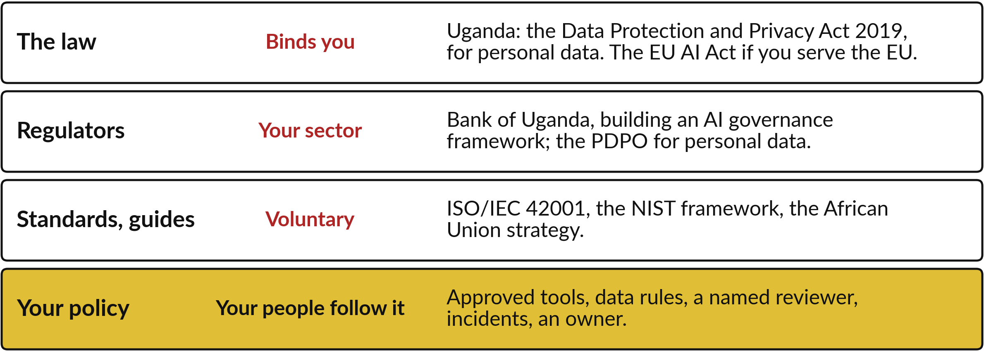
Four layers of rules sit around your AI
use, and only the inner one is yours
My understanding, and not legal advice. Your lawyer confirms what binds you.
Notes:
Your policy sits inside four layers of rules. The outer layer is the law, which binds you whether you like it or not; in Uganda the one I would name first is the Data Protection and Privacy Act of 2019, because it covers personal data. Next, your sector regulator: the Bank of Uganda is building an AI governance framework, and the Personal Data Protection Office acts on personal data.
Then standards and guides, voluntary and free to copy from. The inner layer is yours: the policy your people follow on Monday. I am not a lawyer, so confirm the outer layers with yours.

Slide 19
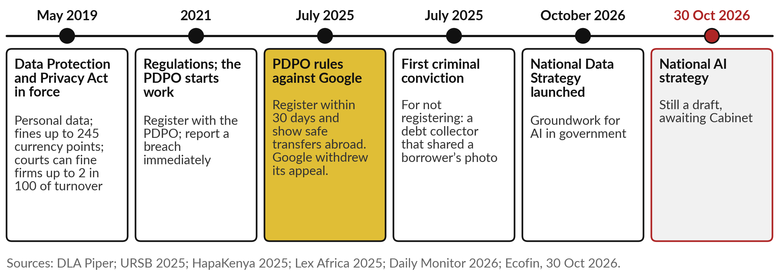
In Uganda the 2019 Act already applies to
AI tools, and the AI strategy is still a draft
No AI-only law yet. Personal data in an AI tool already brings duties.
Notes:
Uganda’s story runs in order, with two cases you met in Session 9. The Data Protection and Privacy Act came into force in May 2019. Most offences carry fines of up to 245 currency points, and courts can fine a company up to 2 in 100 of its annual turnover.
The 2021 Regulations require registration with the Personal Data Protection Office and a report of any breach immediately. In July 2025 the Office ruled against Google, which argued it had no presence in Uganda: register within thirty days and show safe transfers abroad. Google later withdrew its appeal.
The same month brought the first criminal conviction: a debt collector that had shared a borrower’s photo was convicted for not registering. And the national AI strategy is still a draft awaiting Cabinet, as of 30 October 2026. Check again before you teach it.

Slide 20
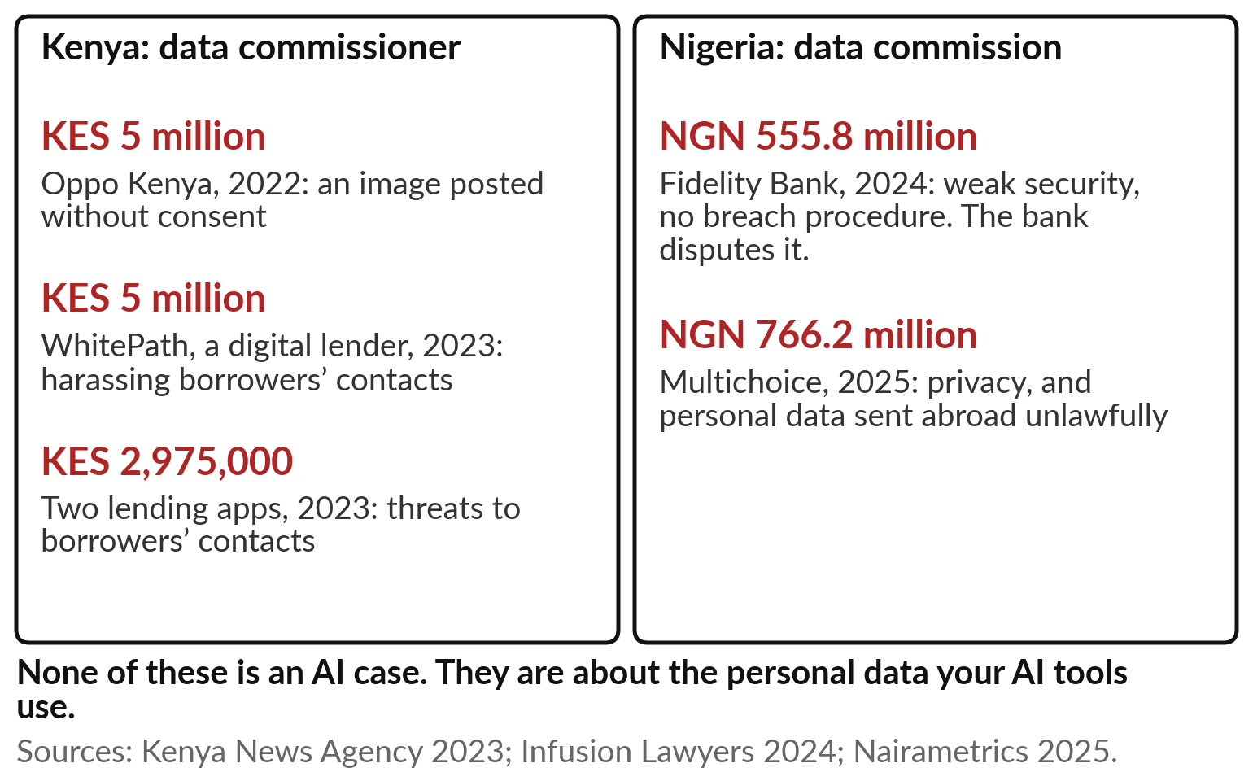
Regulators in Kenya and Nigeria already fine
organisations for misusing personal data
The data your AI uses is already regulated.
None of these is an AI case.
Cloud AI tools often send data abroad, which regulators have fined.
Notes:
Our neighbours show the regulator acting. Kenya’s Data Protection Commissioner fined Oppo Kenya KES 5 million in 2022, then in 2023 a digital lender, WhitePath, KES 5 million, and a company behind two lending apps nearly KES 3 million, for harassing borrowers’ phone contacts. Nigeria’s Commission fined Fidelity Bank NGN 555.8 million in 2024 for weak security and no breach procedure; the bank disputes it.
In 2025 it fined Multichoice NGN 766.2 million, partly for sending personal data abroad unlawfully. None of these is an AI case. They are about the personal data your AI tools use, and a cloud AI tool often sends that data abroad. Vendors, meanwhile, will quote other names at you.

Slide 21
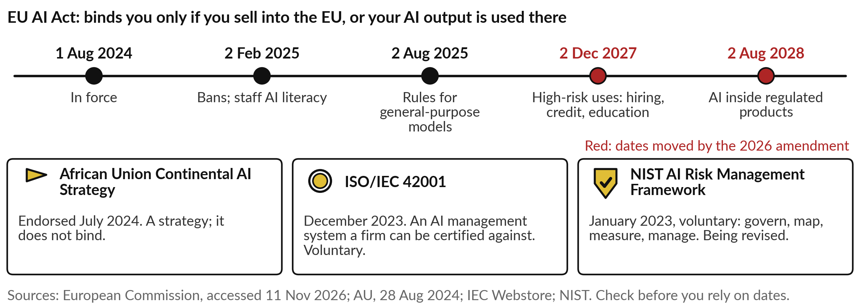
Vendors will quote the EU AI Act, whose dates
moved in 2026, and three voluntary frameworks
Ask a vendor which of these it follows, and ask your lawyer whether the EU Act reaches you.
Notes:
Vendors will bring these names to the meeting. The EU AI Act came into force in August 2024. Its bans and a duty to train staff in AI literacy applied from February 2025, and rules for general-purpose models from August 2025. In 2026 an amendment moved the rules for high-risk uses, such as hiring, credit and education, to December 2027, and for AI inside regulated products to August 2028.
It reaches you if you sell into the EU or your AI output is used there. Then three voluntary ones: the African Union’s continental strategy of July 2024; ISO/IEC 42001, an AI management system a firm can be certified against; and the NIST framework. Our own central bank is writing its rules.

Slide 22
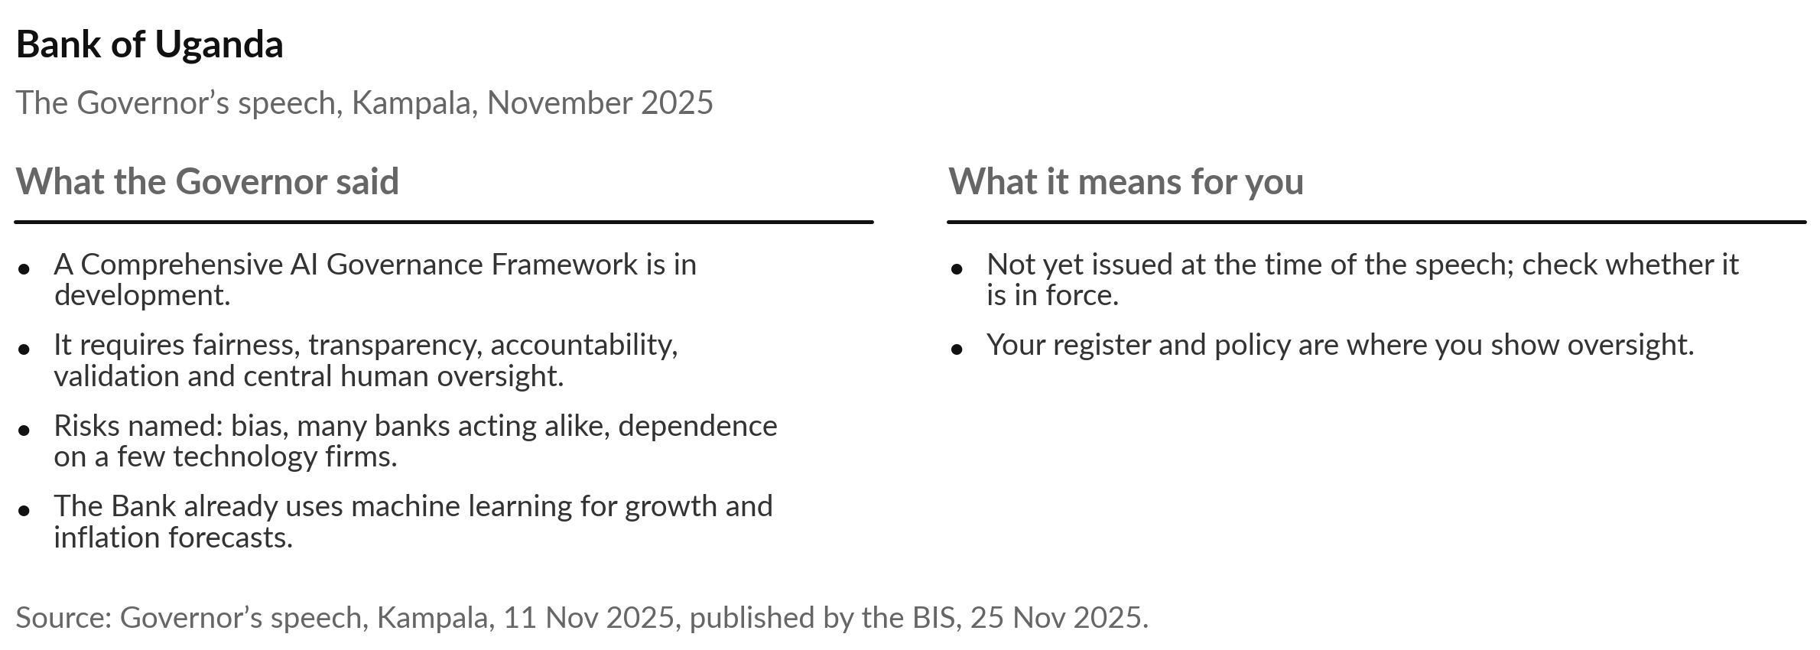
The Bank of Uganda is building an AI governance
framework that requires human oversight
If your regulator asks for oversight, your register and policy are where you show it.
Notes:
The regulator closest to many of you has spoken. In November 2025 the Governor of the Bank of Uganda told a symposium in Kampala that the Bank is developing a Comprehensive AI Governance Framework, requiring fairness, transparency, accountability, validation and central human oversight. He warned of bias, of many banks acting alike, and of dependence on a few technology firms.
The Bank already uses machine learning to refine its growth and inflation forecasts, and trains its own staff. At the time of the speech the framework was still in development, so check whether it has been issued. If your regulator asks for oversight, your register and policy are where you show it. Buying is the last piece.

Slide 23
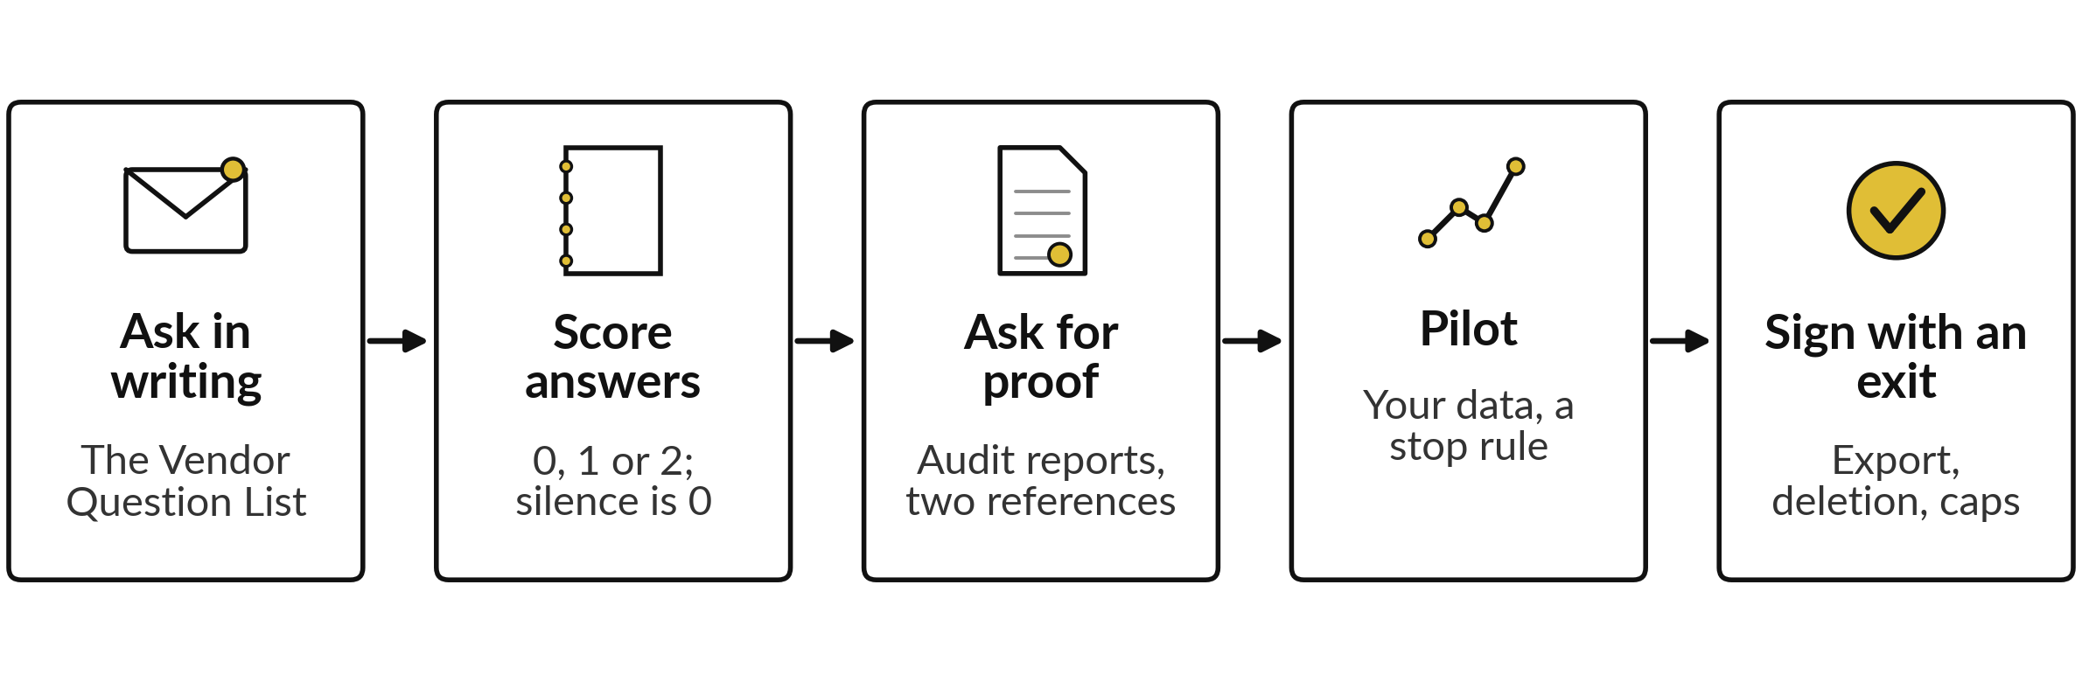
Vendor due diligence: five steps
keep you in control of a purchase
A 0 in data and privacy, security, or contract and exit is a reason to stop.
Notes:
Buying is where governance meets money. Vendor due diligence is checking a supplier before you commit, like asking for a used car’s service history and taking a test drive. Five steps. Send your questions in writing, from the Vendor Question List: thirty questions in six groups. Score each answer zero, one or two, and a silence scores zero.
Ask for proof, such as an audit report and two customers you can call. Run a pilot on your own data, with a person approving every action and a stop rule written first. And sign only with an exit, a way to take your data back and a cap on costs. Then count the full cost.

Slide 24
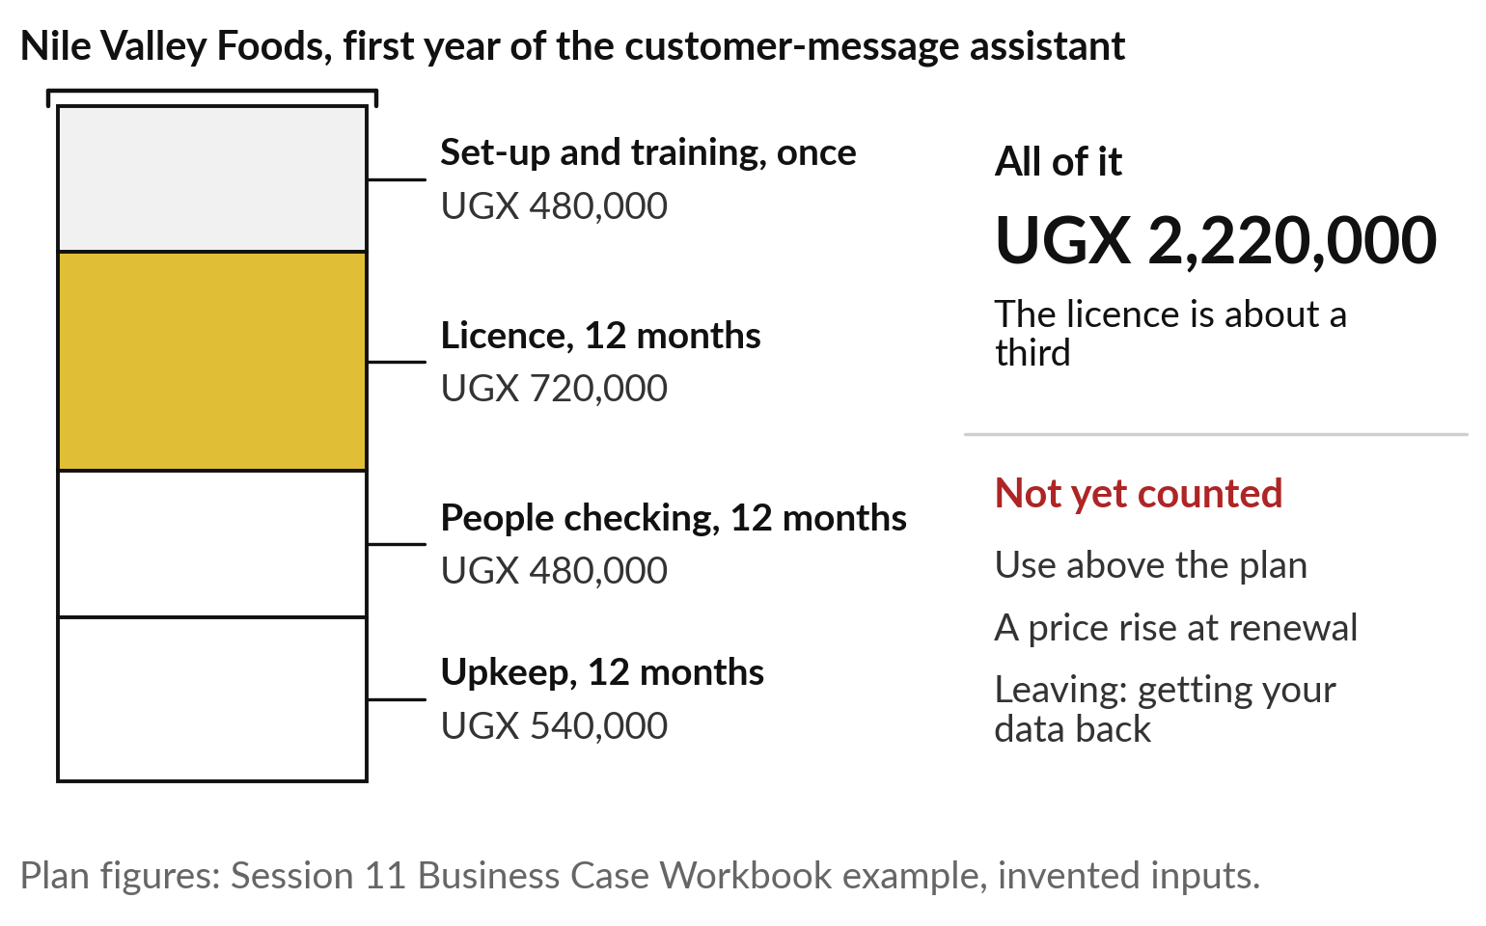
The licence was only about
a third of the first-year cost
Count everything you will pay, in shillings, before you compare vendors.
People’s time is a cost.
Ask what is not in the quote: question 20 of the Vendor Question List.
Notes:
Think of a free phone on a two-year plan: free today, and you still pay every month. A tool is the same. Take the Nile Valley Foods business case from Session 11, in shillings, with invented inputs. Set-up and training once: 480,000. The tool licence: 60,000 a month, so 720,000 for the year.
People checking the output: 480,000. Upkeep: 540,000. In all, UGX 2,220,000, and the licence is only about a third. That total is the total cost of ownership. And it still leaves out use above the plan, a price rise at renewal, and the cost of leaving. Ask every vendor for a realistic first-year total. Now a proposal that hides its costs.

Slide 25
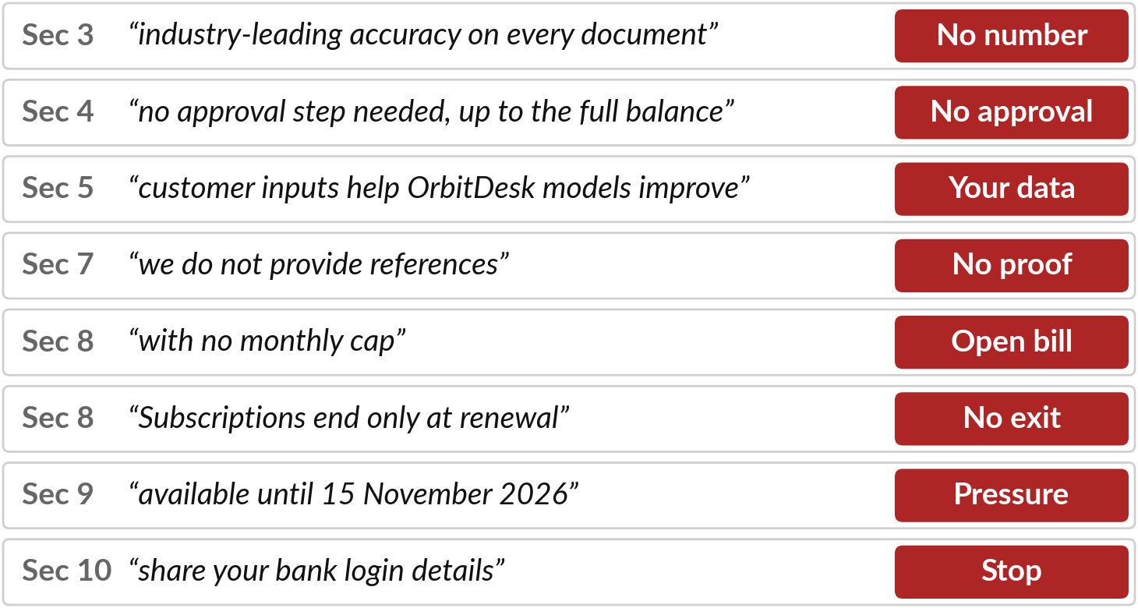
Read the OrbitDesk proposal and
mark every line you cannot check
I will show
Watch for
A claim with no number or source.
What it asks you to share or sign.
What it leaves out.
Notes:
Time to use all of this on a proposal. OrbitDesk is an invented vendor pitching an autonomous finance agent to Nile Valley Foods. You have a printed copy and a highlighter. Read it with me and mark every line you could not check. Section three promises accuracy with no number.
Section four lets the agent pay suppliers with no approval, up to the full bank balance, the agent with too much freedom of Session 10. Section five feeds your data into their models. No references, no cap on usage, no exit, a deadline, and a request for your bank login.
The proposal prices in US dollars, as foreign vendors often do: thirty-six months at USD 2,400 a month commits you to at least USD 86,400. Which line worried you first?

Slide 26
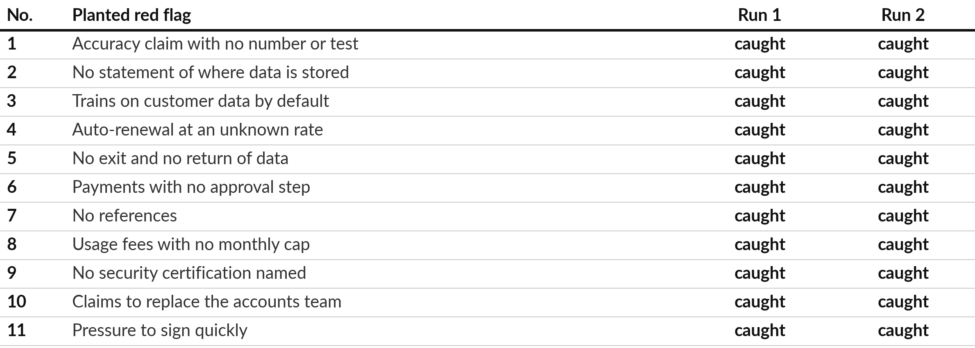
Two fresh AI reviews each caught all
11 red flags the course writers planted
Recorded runs: Claude, two fresh sessions, 4 Nov 2026. Not ChatGPT or Gemini. A blunt proposal.
Notes:
You have marked the lines yourself, so compare with what two AI reviewers made of the same pages. The course writers planted eleven red flags and listed them in an answer key. Two fresh AI sessions got only the proposal and a request: review it, list the red flags and write eight questions.
The key stayed hidden. Both runs caught all eleven, and both found more, such as the bank login request. This is a recorded run of Claude from 4 November 2026; another product or another day may differ. And the proposal is deliberately blunt; a real one is quieter. That raises whether you can hand the review to the AI.

Slide 27
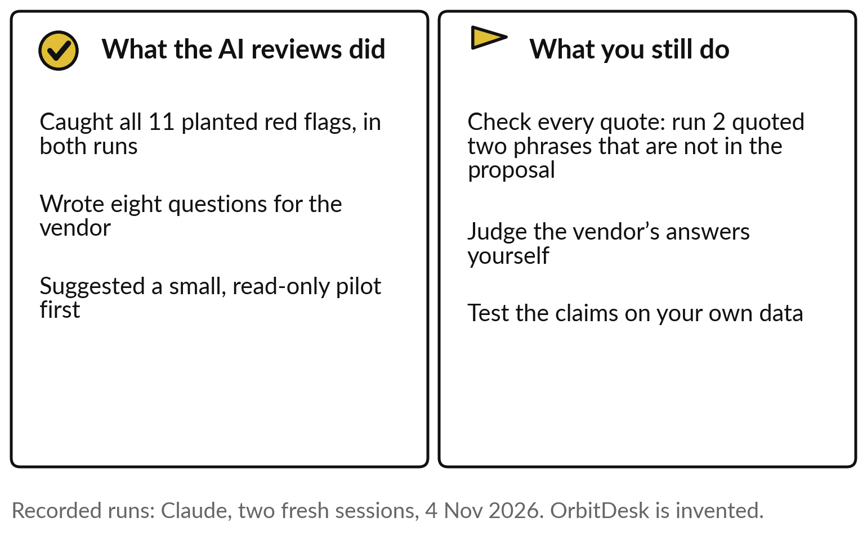
The AI review helped, and you still
check its quotes and make the call
Use AI as a second reader. You decide.
A confident quote can be wrong.
Check it against the page.
Test claims on your own data.
Notes:
Eleven out of eleven might tempt you to hand the whole job over, so here is what it still leaves to you. The AI was a useful second reader: it found everything planted, wrote sensible questions and suggested a small, read-only pilot with a person approving every payment.
But run two quoted two phrases, tens of thousands of invoices and sign now, and neither is in the proposal. A confident quote can be wrong, the invented sources of Session 9 again. So check every quote against the page, judge the vendor’s answers yourself, and test the claims on your own data. After a five-minute break, you write your own rules.

Slide 28
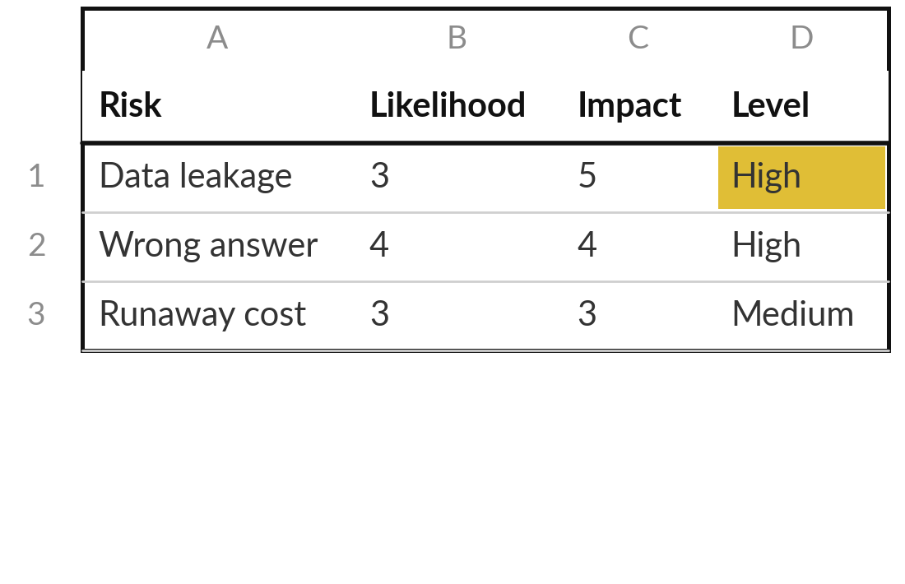
Block 1: score the risks of your own AI uses
15 minutes
Hands-on: your own rules
Edit the Risk Register for the AI uses in your portfolio.
Open Risk Register.xlsx. Edit the eight grey rows for your own uses.
Score likelihood and impact from 1 to 5, using the words.
Name one owner and a control for your top five.
Add one risk of your own.
You keep: Five scored risks, each with an owner and a control.
Notes:
Welcome back. For the next hour you write your own rules, in five blocks, and I walk round. This block is fifteen minutes. Open the Risk Register. The eight grey rows are the typical AI risks we placed on the grid. Edit them for the uses in your portfolio.
Score likelihood and impact from one to five, reading the words on the Scale sheet, and the sheet works out the score and the level. Then name one owner for each of your top five and write a control: a real action that lowers the likelihood or the impact.
Add one risk of your own, such as staff trusting the tool too much. Tell me which row you scored High.

Slide 29
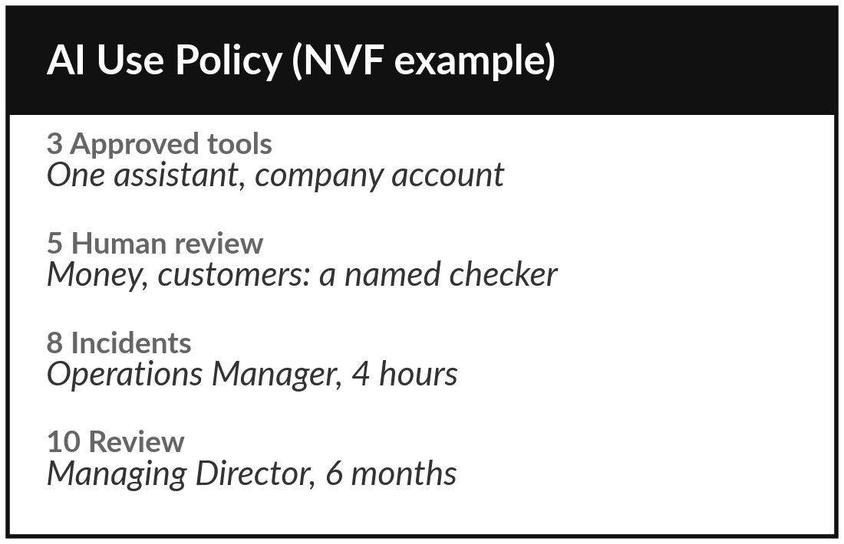
Block 2: draft six sections of
your acceptable use policy
15 minutes
Hands-on: your own rules
Draft sections 3, 4, 5, 7, 8 and 10 of the AI Use Policy Template.
3: approved tools, each with an owner.
4: the data table, with the four questions.
5: what always needs a named reviewer.
7, 8, 10: accounts, incidents, review date.
You keep: Six sections of your policy draft.
Notes:
Your register says what to guard against, so the policy tells staff how. Fifteen minutes. Open the AI Use Policy Template. Section three: the approved tools, each with an owner, matching what your briefing promised in Session 12. Section four: the data table, using the four questions. Section five: what always needs a named reviewer, such as payments, contracts and hiring.
Sections seven, eight and ten: company accounts and owners, who hears about an incident and how fast, and the review date. Replace every square bracket in the template with your own words. The other five sections can wait until after class.

Slide 30
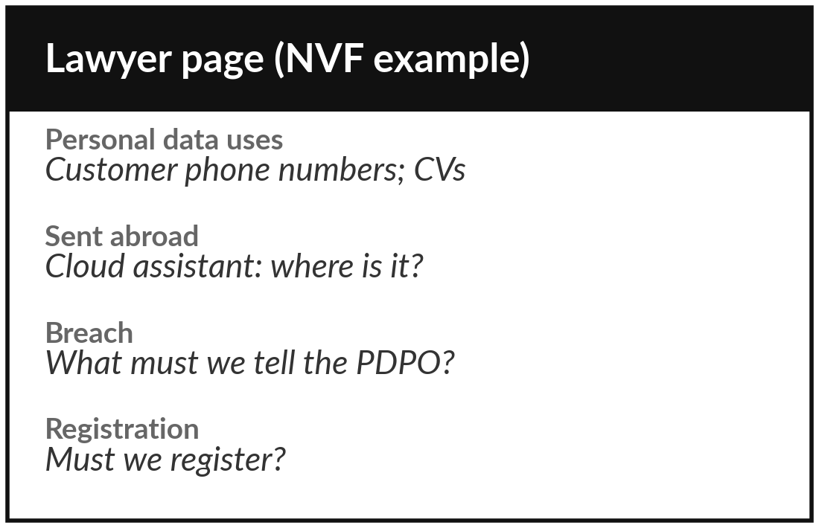
Block 3: write the page you take to your lawyer
10 minutes
Hands-on: your own rules
Prepare your questions on the law.
Find Questions to take to my lawyer at the end of the template.
Mark which of your AI uses involve personal data.
Mark any data sent abroad, or any EU customers.
Write the date you will see your lawyer.
You keep: A lawyer page, with your uses marked and a date.
Notes:
Your data rules depend on the law, so this block is for your lawyer. Ten minutes. The template ends with questions to take to your lawyer. Which of our AI uses involve personal data?
What are our duties under the 2019 Act for each?
Must we register with the Personal Data Protection Office?
When must we report a breach?
What must a vendor contract say about our data, and where it is stored?
Mark which of your own uses involve personal data, and any that send data abroad or serve customers in the EU. Then write the date you will see your lawyer.

Slide 31
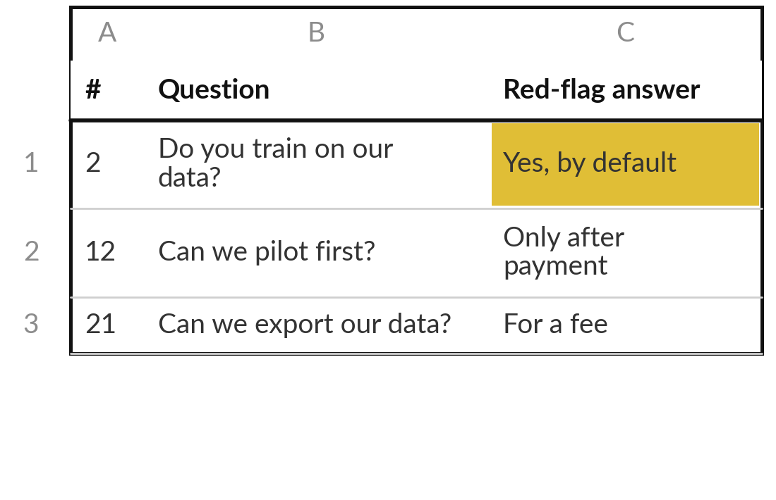
Block 4: vendor questions and
the full first-year cost for one tool
15 minutes
Hands-on: your own rules
Use the Vendor Question List on one tool you use, trial or were offered.
Answer the data, security, and contract and exit groups. Silence scores 0.
Choose five questions that matter most.
Write the answer that would worry you.
List every first-year cost in shillings.
You keep: Five questions with red-flag answers, and a first-year total.
Notes:
With the law page ready, look outward at a tool someone is selling you. Fifteen minutes. Pick one tool your organisation uses, is trialling or was offered; if you have none, use OrbitDesk. Open the Vendor Question List and answer the groups on data and privacy, security, and contract and exit from what you know today.
Where you do not know, leave it blank, because a silence scores zero. Choose the five questions that matter most and write the answer that would worry you. Then list every first-year cost in shillings, as in the Nile Valley Foods example, including your people’s time.

Slide 32
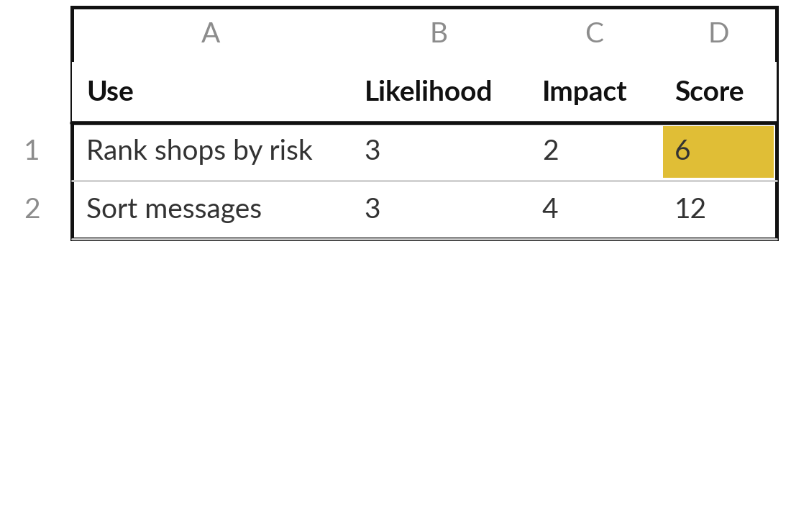
Block 5: add the risk score to every
entry in your AI Opportunity Portfolio
5 minutes
Hands-on: your portfolio
Score likelihood and impact for each portfolio entry.
Open the sheet People, risk, data.
For each entry: likelihood and impact, 1 to 5.
The sheet multiplies them.
Mark the High ones.
You keep: The risk column filled for every entry.
Notes:
The last block is five minutes, and it carries today into your portfolio. Open the AI Opportunity Portfolio, sheet People, risk, data, next to the people columns you filled in Session 12. For each entry, score the worst risk you can see: likelihood and impact, one to five each.
The sheet multiplies them for you. Mark any entry that scores High. A High score does not kill an idea; it tells you the controls must come first. In Session 14 you add whether the data is ready, and choose what to start in the next ninety days.

Slide 33
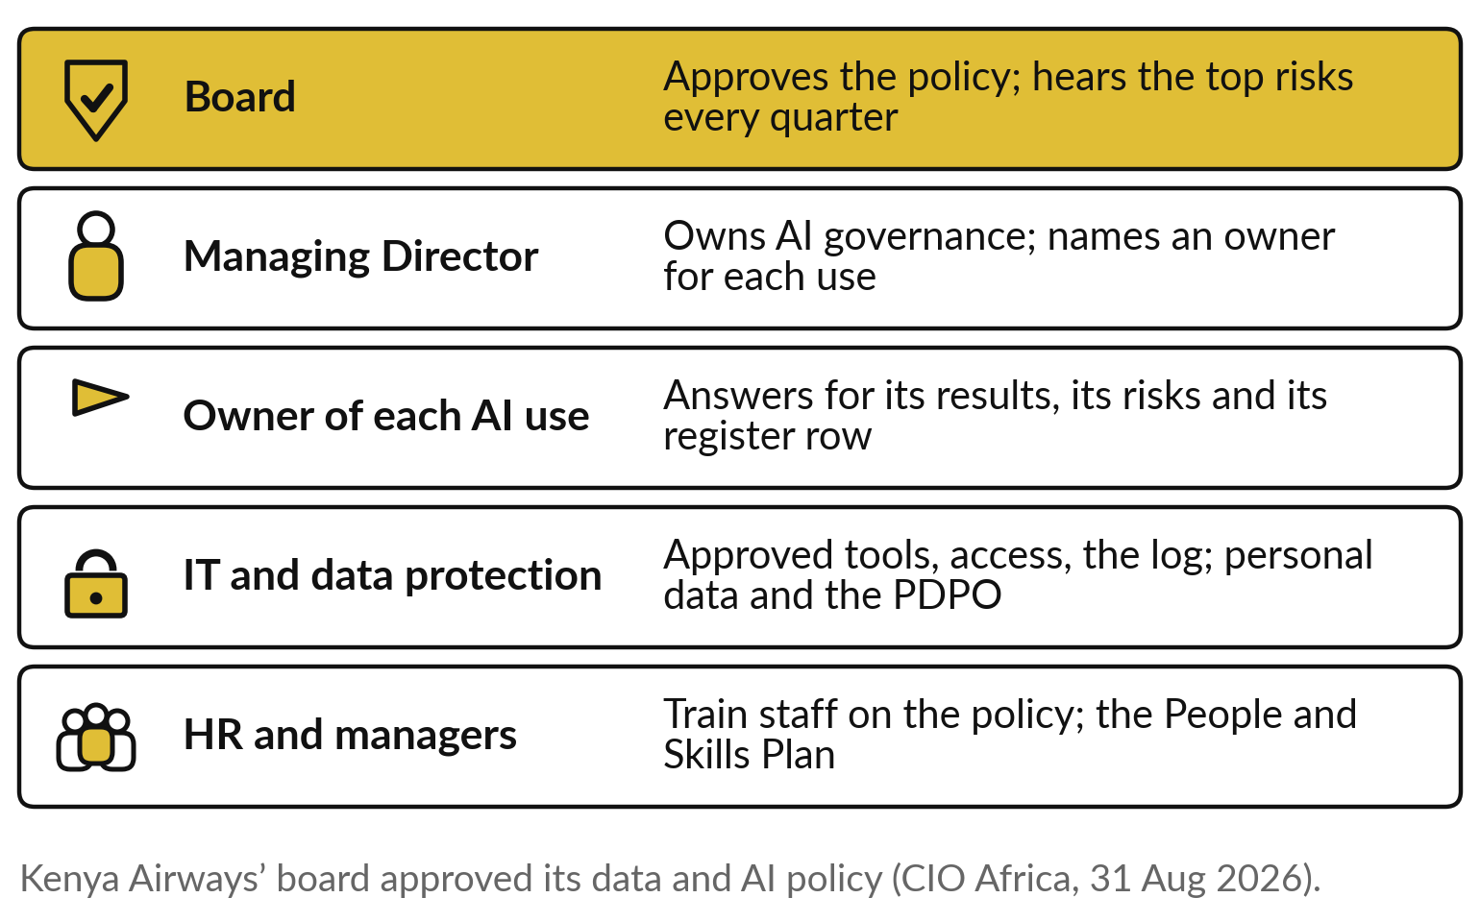
Name who owns AI governance, from
the board to the owner of each use
Every rule you drafted needs a name next to it.
The board approves; the Managing Director owns.
Each use has one owner.
HR trains staff on the policy.
Notes:
You have drafts; now each needs a name. The board approves the policy and hears the top risks every quarter, as Kenya Airways’ board did. The Managing Director owns AI governance and names an owner for each use. Each use’s owner answers for its results, its risks and its row in the register.
IT and whoever handles data protection look after the approved tools, access, the log and personal data. And HR and managers train staff on the policy, at the levels you planned in Session 12, so the policy lives in daily work. Name a deputy too, so nothing stalls when one person is away. Then tell the board.

Slide 34
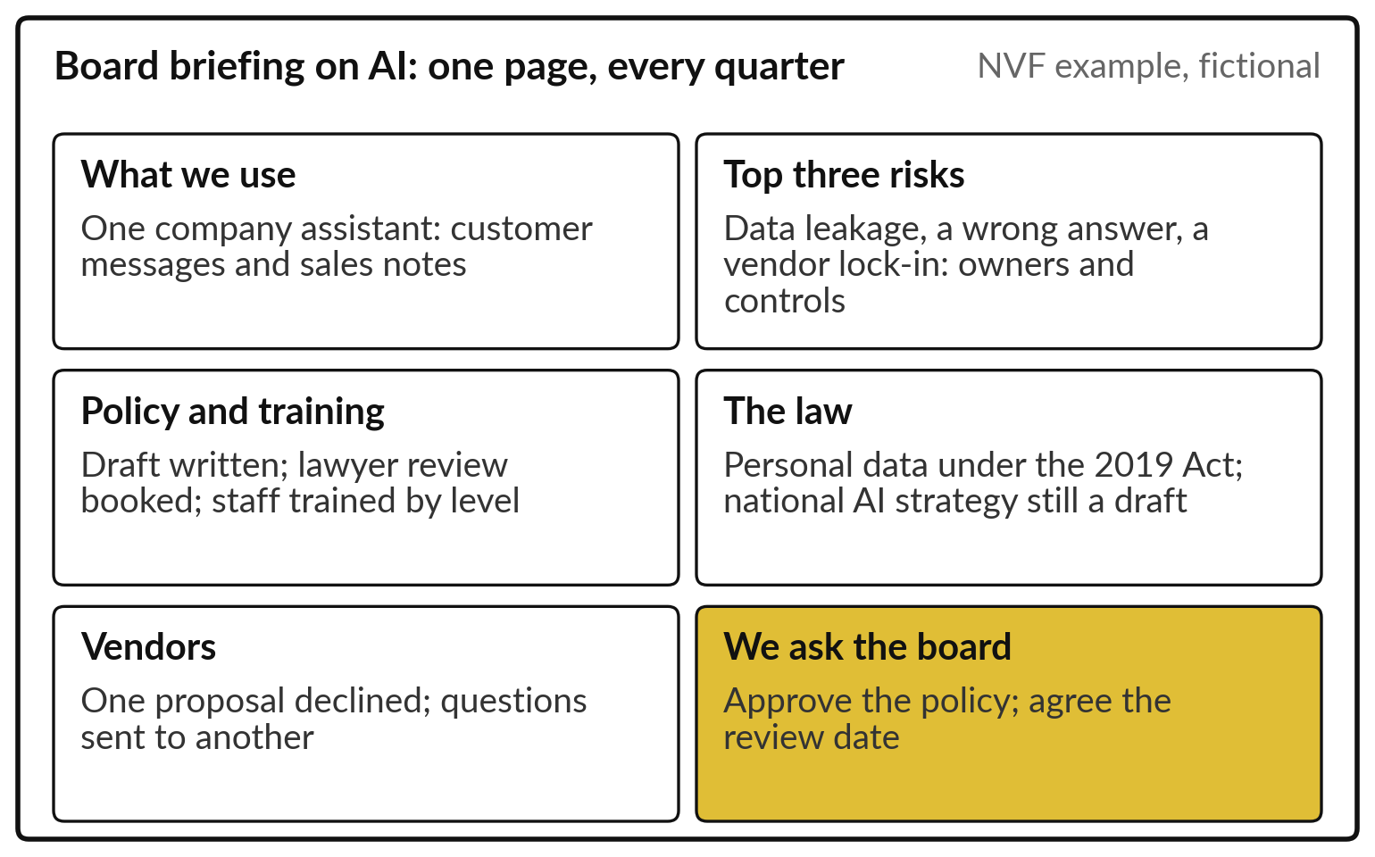
Brief the board on one page: what you use, the
top risks, the policy, the law and your request
One page, every quarter, ending with a decision you need.
Top three risks, each with an owner.
The law in one line.
End with what you ask the board.
Notes:
Boards have little time, so the briefing fits on one page and comes every quarter. What we use. The top three risks from the register, each with its owner and control. The state of the policy and the training. The law in one line: personal data under the 2019 Act, and the national AI strategy still a draft.
Vendor decisions since last time. And it ends with what you ask the board to decide, such as approving the policy and the review date. The Nile Valley Foods example is fictional. Write yours from today’s drafts. Now, your decision on the next proposal.

Slide 35



Every proposal gets declined,
questioned in writing or piloted small
A vendor sends you a proposal tomorrow. Which route do you take?
Decline
Ask in writing
Run a pilot
A red flag on payments, bank access or your data, with no fix
Send your five questions; decide when the answers come
Small, your data, a person approving every action, a stop rule
Write the route, the reason and the first step in your workbook.
Notes:
You hold a register, a policy draft, a lawyer page, vendor questions and a board page, so use them. A vendor sends you a proposal tomorrow. Decline, when a red flag on payments, bank access or your data has no fix. Ask in writing, when it is promising but silent on what matters: send your five questions, score the answers, and decide when you have them.
Or run a pilot, when the answers are good: small, on your own data, with a person approving every action and a stop rule written first. Which route do you take, and what is your first step? Write it down.

Slide 36
A policy, a scored register and written
vendor checks keep your promises to staff
Every High and Medium risk gets an owner and a control.
Approved tools beat a ban.
Classify data: the strictest answer wins.
Buy with written questions, the full cost and an exit.
Notes:
The register’s grid is a fair summary of the session. A policy with approved tools beats a ban, because a ban hides the use. Score each risk for how likely and how bad, from one to five, and give it one owner and a control. Classify data with four questions, and let the strictest answer win.
Know the law: the 2019 Act already covers personal data in AI tools, regulators in the region fine, and your lawyer confirms the rest. And buy with care: questions in writing, the full cost in shillings, and always an exit. The AI review helped, and you still checked its quotes against the page.

Slide 37
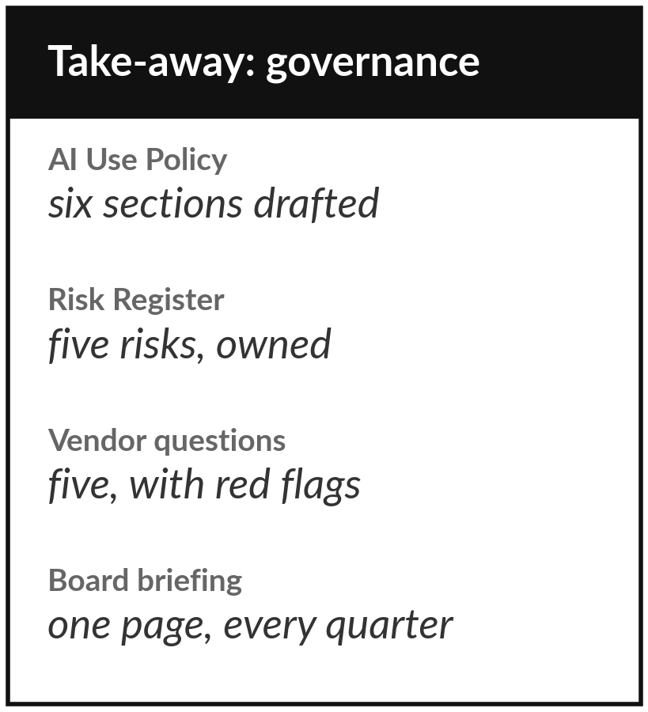
Take your drafts to a colleague
and your lawyer this month
What you keep from today
Your AI Use Policy draft, your Risk Register, your lawyer page, your Vendor Question List, the risk column of your portfolio, and a board briefing outline.
Our question today
What rules, risk register and vendor checks does my organisation need for AI?
Next session
Session 14: Data readiness, AI roadmap and your 90-day plan.
Notes:
So you leave with drafts, and drafts are meant to be read. Share the policy with one colleague and your lawyer before anyone signs it. Keep the register alive: look at it every quarter, and add a row whenever a new use starts. Keep the vendor questions for the next proposal on your desk, and brief your board on one page.
Your rules are only as good as the information they protect. In Session 14, the last, we check whether your data is ready and write your ninety-day plan.
We began with this question: What rules, risk register and vendor checks does my organisation need for AI? Before you go, say in one sentence what you can now say about it.

